Slide 1
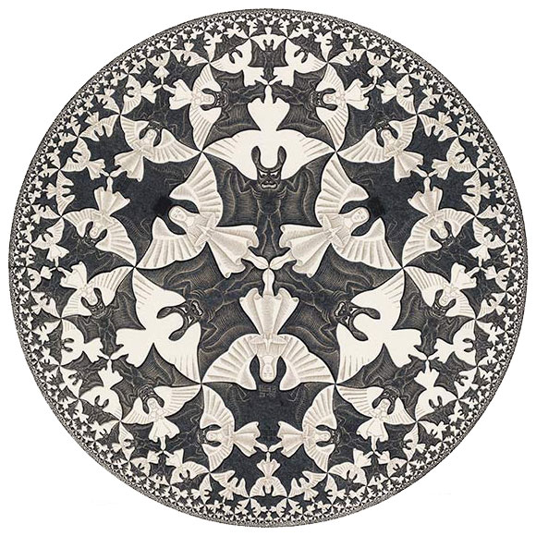
The Beauty of the Hyperbolic Plane
Isabel Beach
University of Toronto

Slide 2
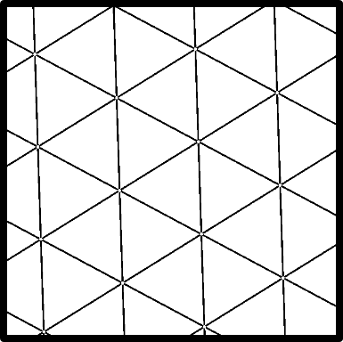
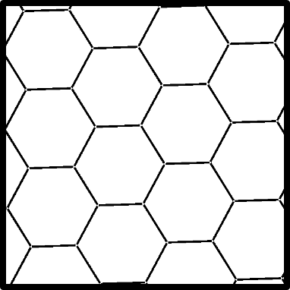
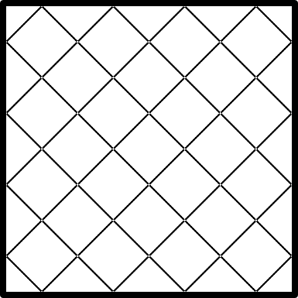
Regular Euclidean Tilings
Image credit: https://en.wikipedia.org/wiki/List_of_regular_polytopes_and_compounds
Only 3! Polygon angles must add up to 360° at each vertex

Slide 3
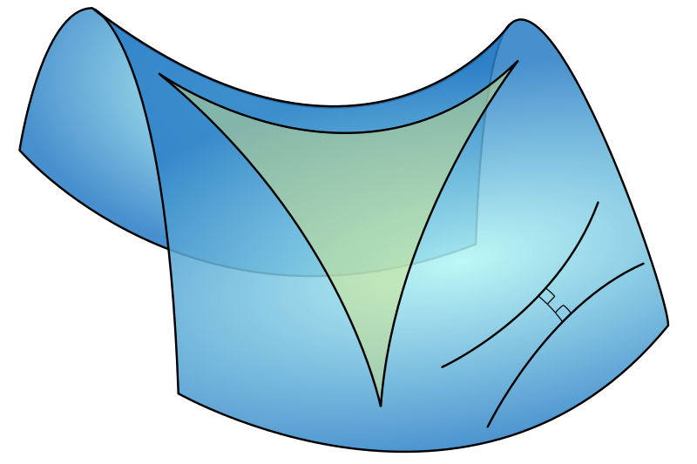
Hyperbolic Space
Negative Curvature (not flat!)
Angles in a Triangle add up to < 180°
Can fit “more” polygons into our tilings
Image credit: https://en.wikipedia.org/wiki/Hyperbolic_geometry

Slide 4
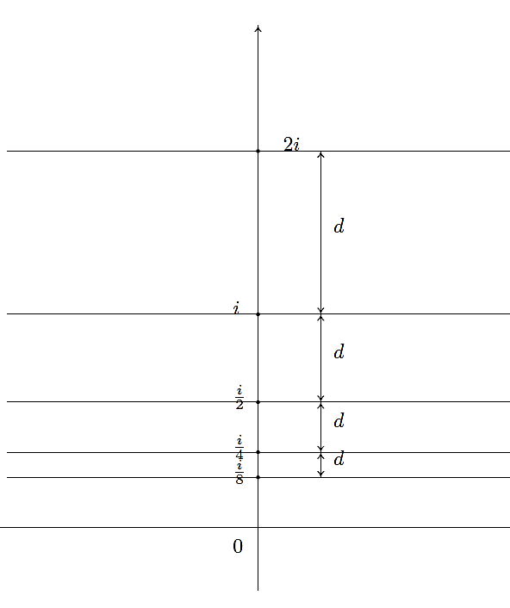
The Half-Plane Model
Complex numbers with positive imaginary part
Curvature is determined by the hyperbolic metric:
$$ds^{2}=\frac{1}{y^{2}}\left(dx^{2}{+dy^{2}}\right)$$
Distance grows exponentially as we approach the real line
Image credit: Caroline Series

Slide 5
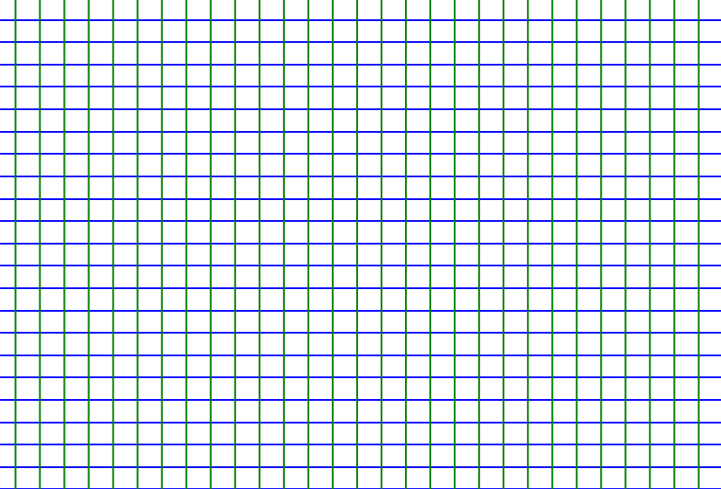
$$z↦\frac{z−i}{z+i}$$
The Cayley Map
Maps upper half-plane bijectively onto unit disk
Maps real-line into the unit circle
Preserves angles and distances
Converts plane model to a disk model (“The Poincaré Disk Model”)

Slide 6
Regular Hyperbolic Tilings
Tilings are characterized by Schläfli Symbols (p,q):
p = # of sides of each tile
q = # of polygons meeting at each vertex
Example: Euclidean square tiling is (4,4)
Which Schläfli Symbols are hyperbolic?

Slide 7
Regular Hyperbolic Tilings
Interior angles of regular polygon with p sides:
$θ=π\left(p−2\right)/p$ (in Euclidean space)
In hyperbolic geometry,$θ$ will be lower
In spherical geometry,$θ$ will be higher
Total angle at vertex with q polygons:
$φ=qθ=πq\left(p−2\right)/p$

Slide 8
$$q\left(p−2\right)/p$$
 |  | p
 |  | 3 | 4 | 5 | 6 | 7 | 8 | 9
q | 3 | 1 | 1.5 | 1.8 | 2 | 2.14 | 2.25 | 2.33
 | 4 | 1.33 | 2 | 2.4 | 2.67 | 2.86 | 3 | 3.11
 | 5 | 1.67 | 2.5 | 3 | 3.33 | 3.57 | 3.75 | 3.89
 | 6 | 2 | 3 | 3.6 | 4 | 4.29 | 4.5 | 4.67
 | 7 | 2.33 | 3.5 | 4.2 | 4.67 | 5 | 5.25 | 5.44
 | 8 | 2.67 | 4 | 4.8 | 5.33 | 5.71 | 6 | 6.22
 | 9 | 3 | 4.5 | 5.4 | 6 | 6.43 | 6.75 | 7

Slide 9
Regular Hyperbolic Tilings
Spherical:$πq\left(p−2\right)/p<2π$
5 choices, corresponding to the 5 platonic solids
Euclidean: $πq\left(p−2\right)/p=2π$
3 choices, corresponding to our original 3 regular tilings
Hyperbolic: $πq\left(p−2\right)/p>2π$
Infinitely many choices!
For any p, just pick q large enough

Slide 10
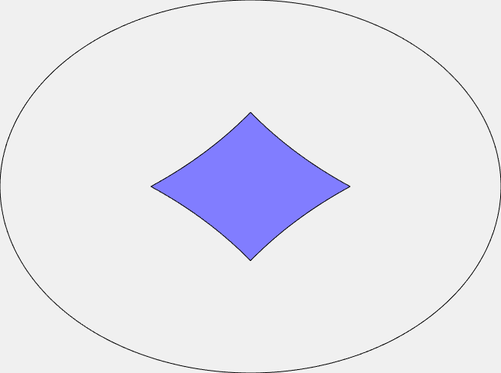
We can always find a hyperbolic p-sided polygon with arbitrarily small interior angles
Can always fit in more tiles at each vertex

Slide 12
Now we know which polygons we can use.
But which transformations can we use?

Slide 13
Regular Hyperbolic Tilings
Like in the Euclidean example, want our tiles to be congruent.
Translations, rotations, reflections
Isometries
What is the hyperbolic equivalent?

Slide 14
Mobius Maps
$$\left(\begin{matrix}a & b \\ c & d\end{matrix}\right)↔\left(z↦\frac{az+b}{cz+d} \right)$$
2x2 matrices give rise to maps of the complex plane

Slide 15
Mobius Maps
Mobius maps with real coefficients and determinant 1 are the isometries (distance-preserving maps) of the hyperbolic plane
This group is called PSL(2,$\text{ℝ}$) (“Projective Special Linear Group”)
(“Projective” means we identify the matrices A and –A, which give the same Mobius map)
PSL(2,$\text{ℝ}$) = $\left\{\left(\begin{matrix}a & b \\ c & d\end{matrix}\right) | a,b,c,d∈\text{ℝ}\text{, }ad−bc=1\right\}$

Slide 16
Types of Mobius Maps

Slide 17
Classification by Fixed Points
$$\frac{az+b}{cz+d}=z ⇒0=cz^{2}+\left(d−a\right)z−b$$
$$z=\frac{\left(a−d\right)±\sqrt{{\left(d−a\right)}^{2}+4cb}}{2c}$$
$$=\frac{\left(a−d\right)±\sqrt{{Trace}^{2}−4}}{2c}$$
The number of fixed points is determined by the trace (a+d).
Recall:
$$ad−bc=1$$

Slide 18
Classification by Fixed Points
Map Name | Trace | Fixed Points
Elliptic | |Trace| < 2 | 2 Complex (1 in upper half plane)
Parabolic | |Trace| = 2 | 1 Real
Hyperbolic | |Trace| > 2 | 2 Real

Slide 19
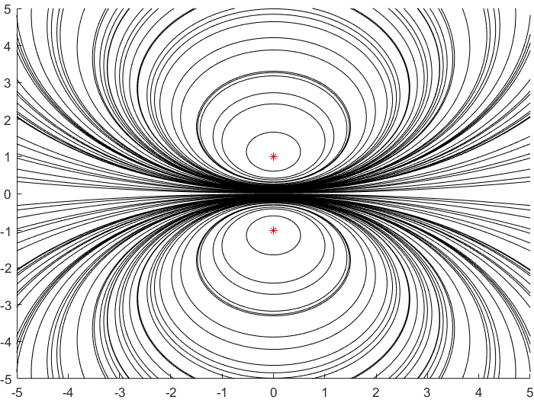
Elliptic
|Trace| < 2
2 complex conjugate fixed points
Analogous to rotation (on a sphere)

Slide 20
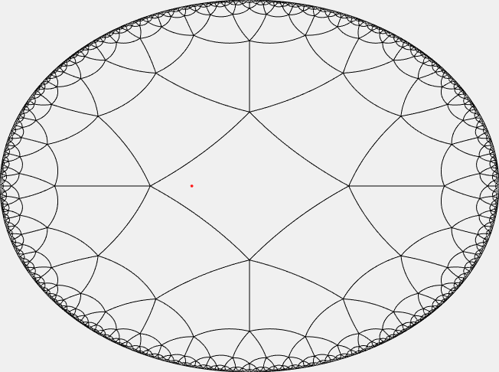
Fixed Point
at red star

Slide 21
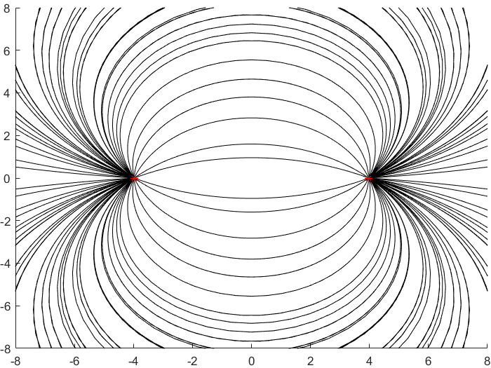
Hyperbolic
|Trace| > 2
2 real fixed points
Analogous to scaling

Slide 22
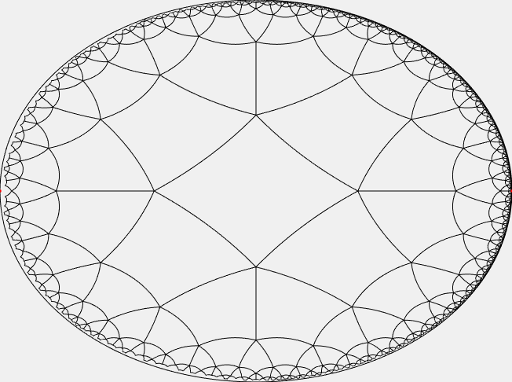
Fixed Point
Fixed Point

Slide 23
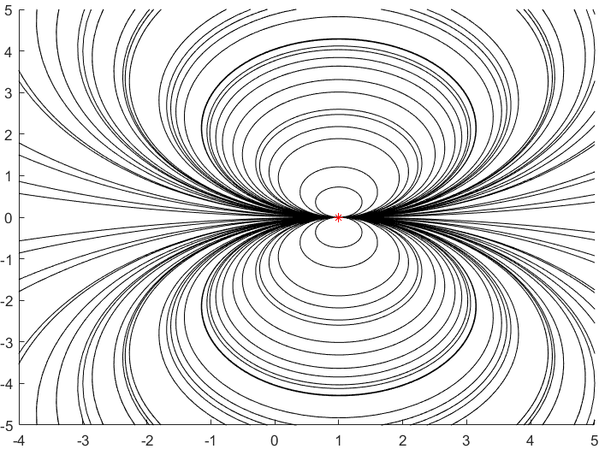
Parabolic
|Trace| = 2
1 real fixed point
Analogous to translation

Slide 24
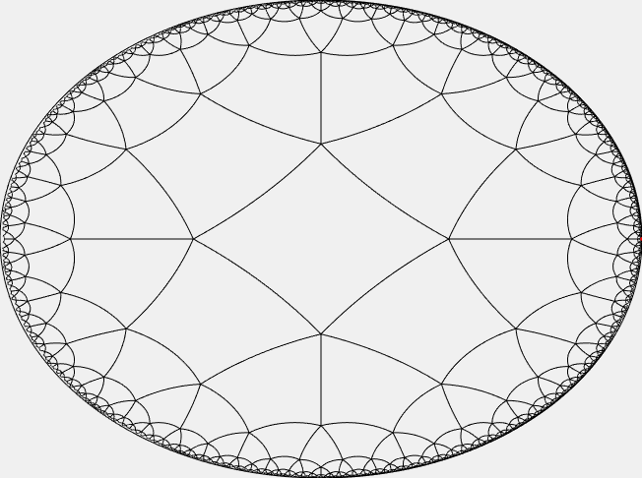
Fixed Point

Slide 25
Examples of Regular Hyperbolic Tilings

Slide 26
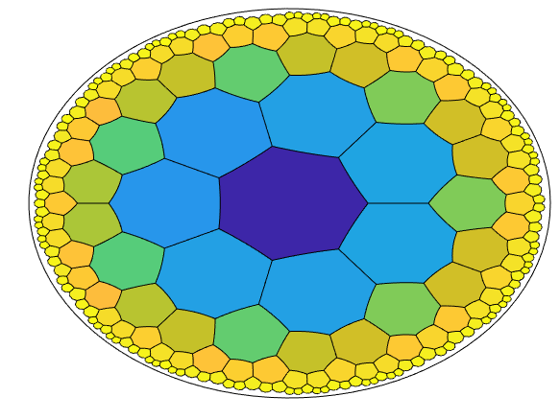

Slide 27
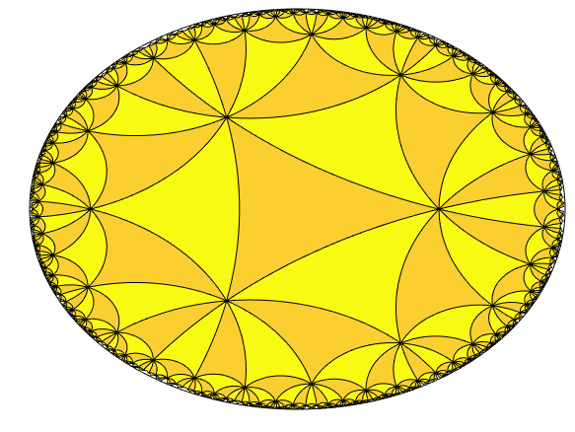
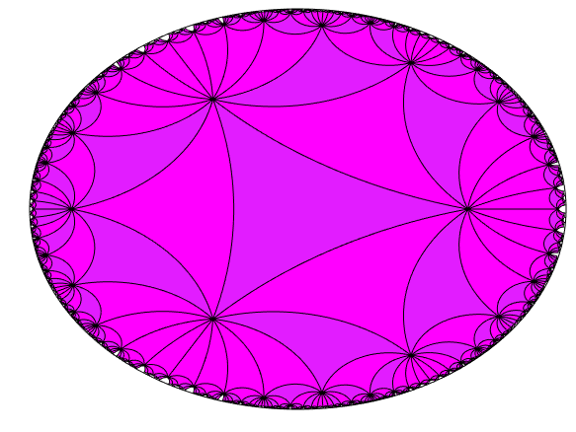
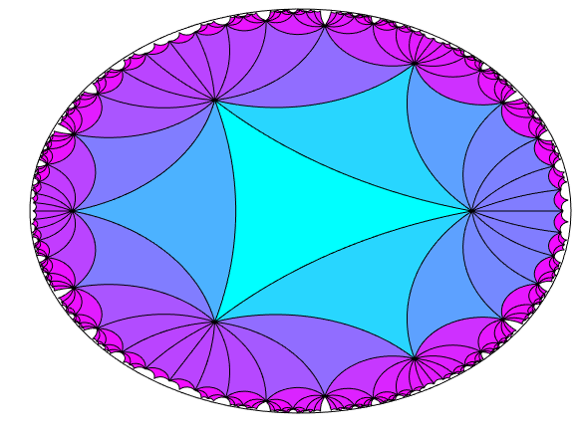
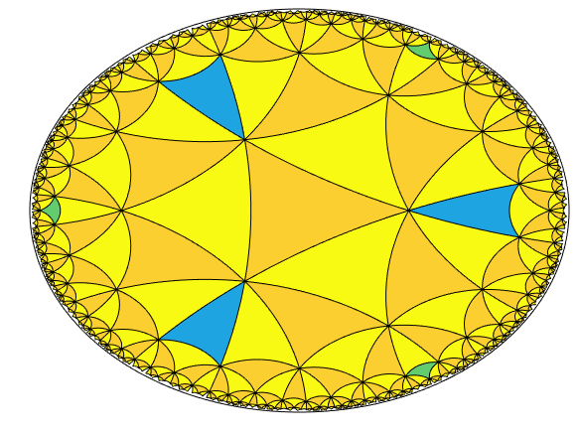
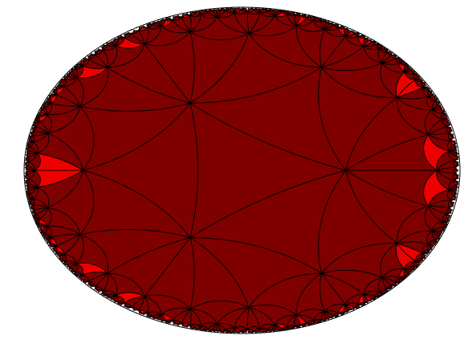

Slide 28
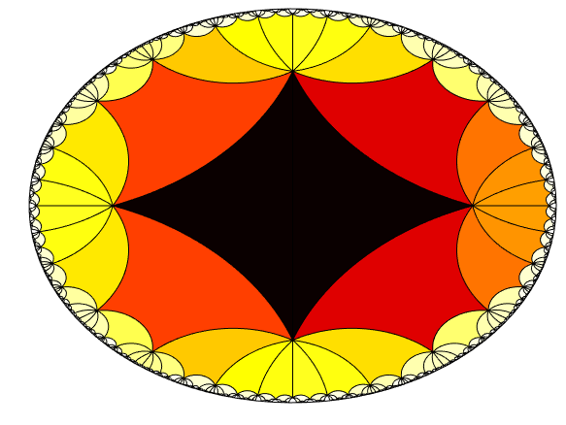
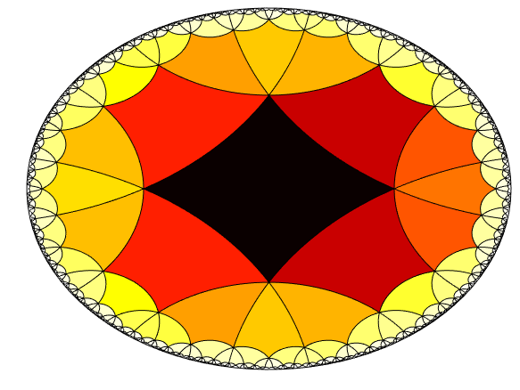
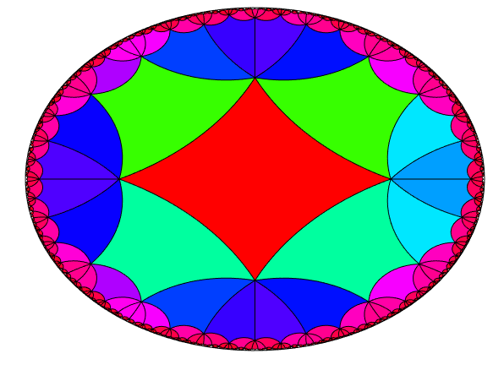
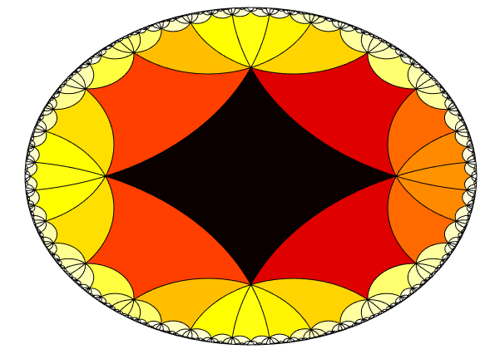
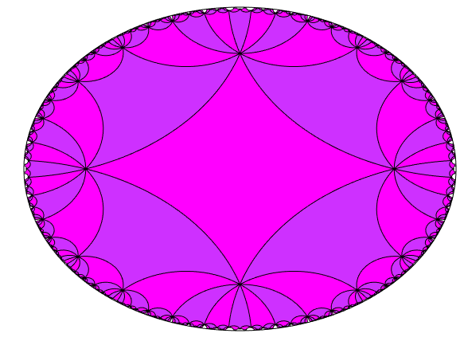

Slide 29
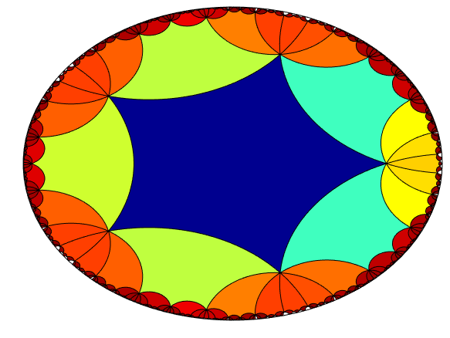
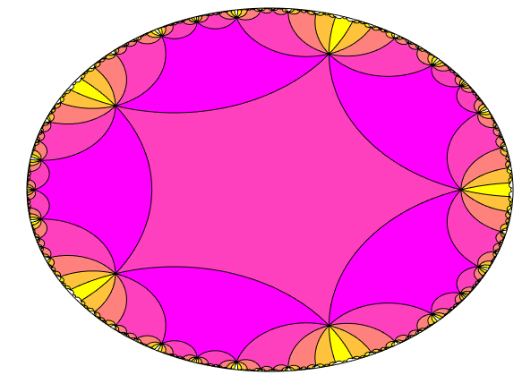
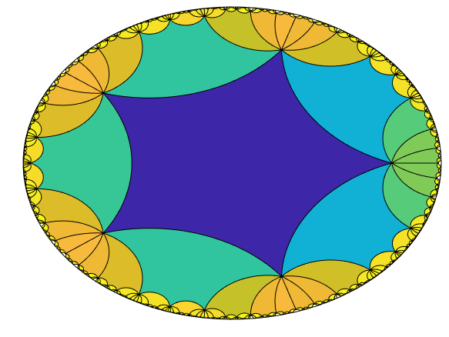
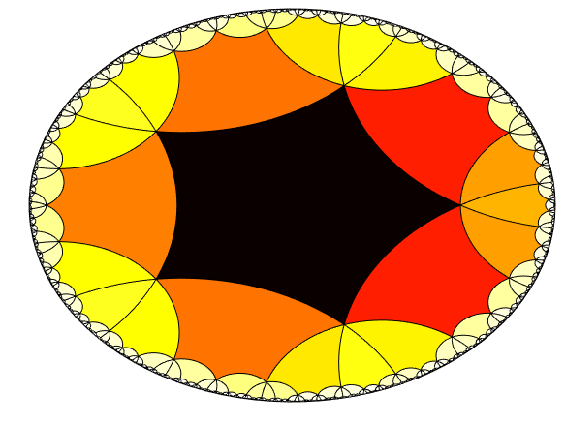
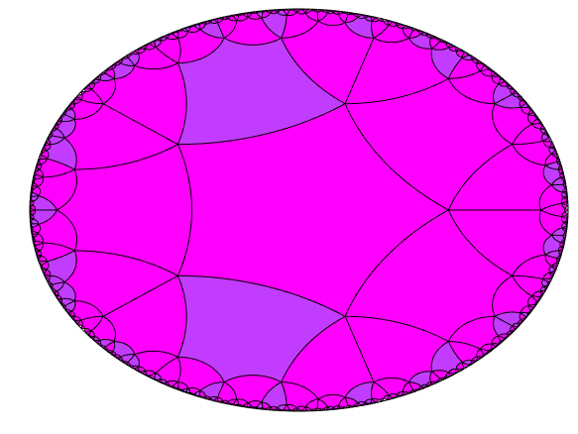

Slide 30
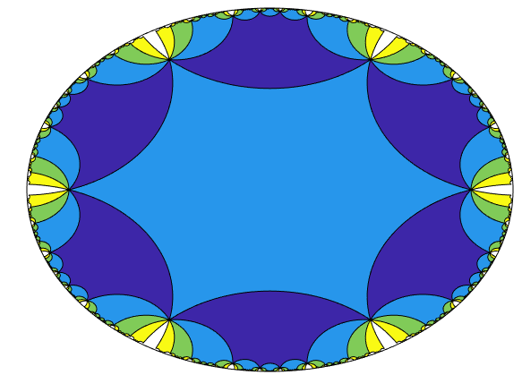
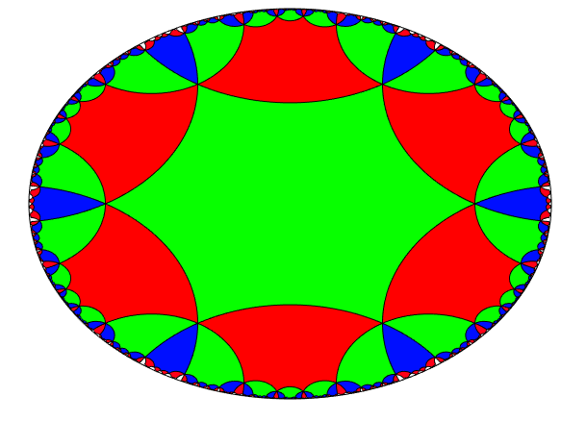
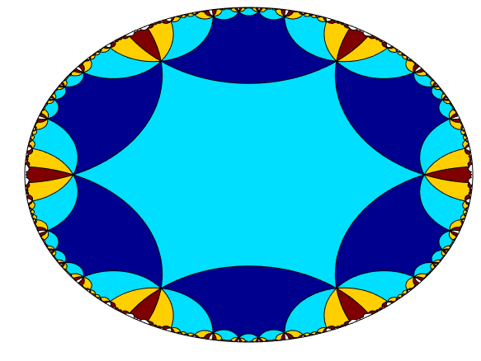
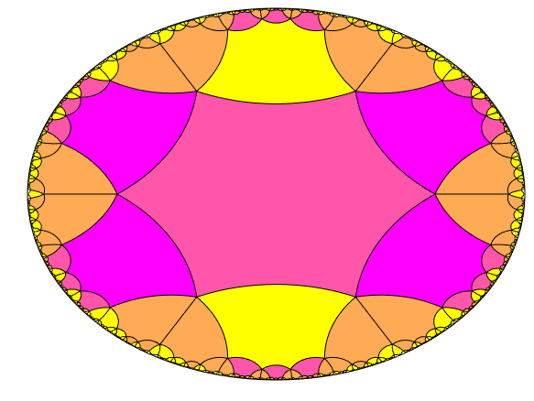
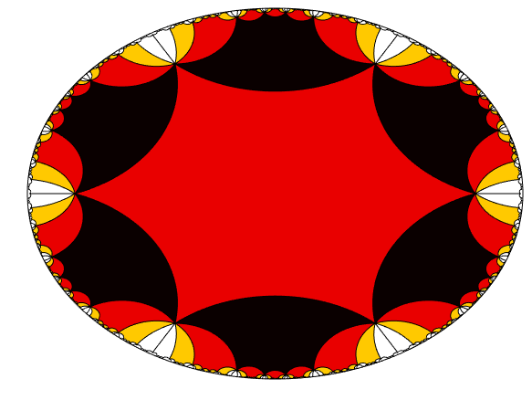

Slide 31
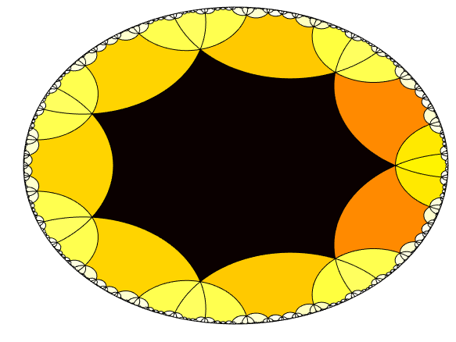
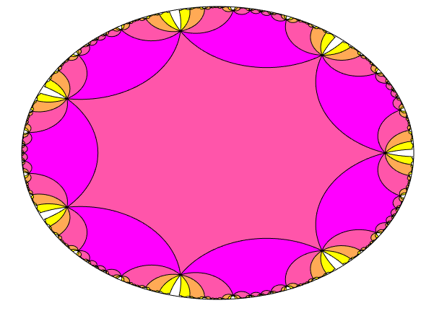
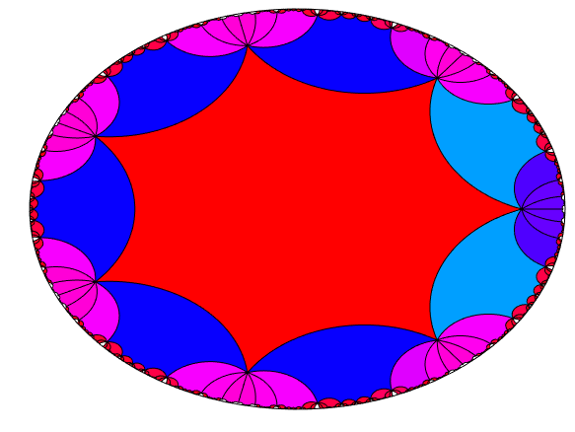
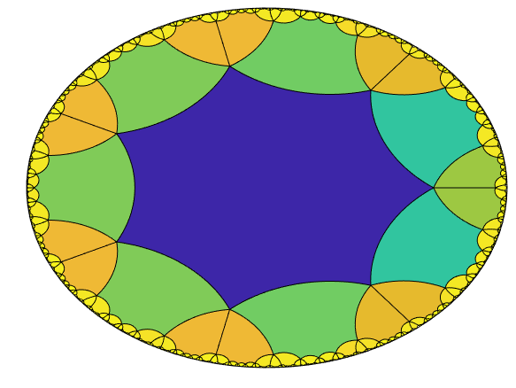
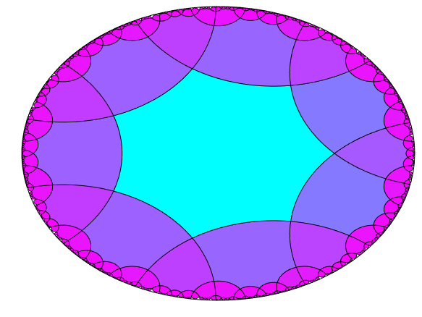

Slide 32
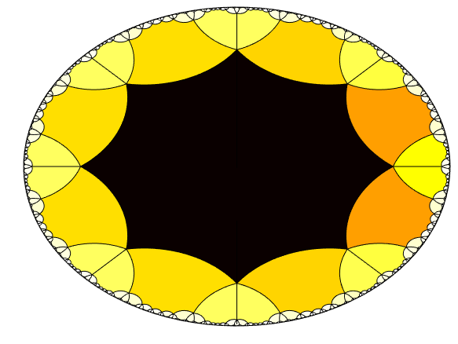
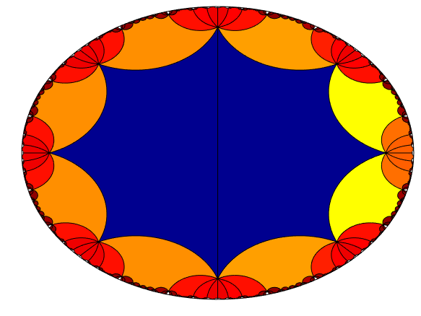
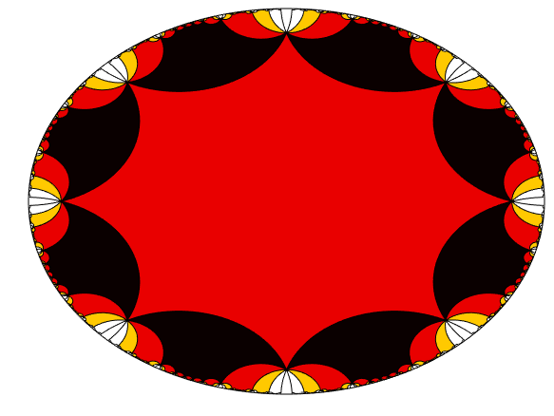
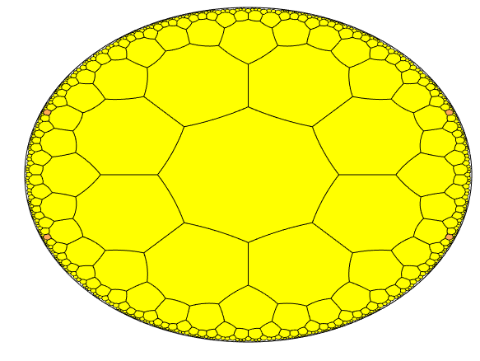
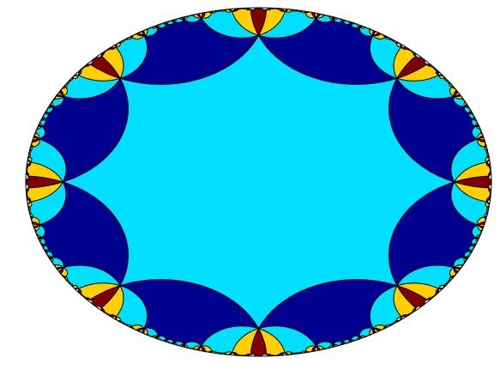

Slide 33
Ideal Polygons: Vertices at “infinity” Symbol (p,$∞$)

Slide 34
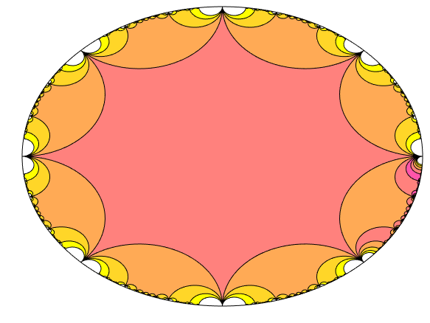
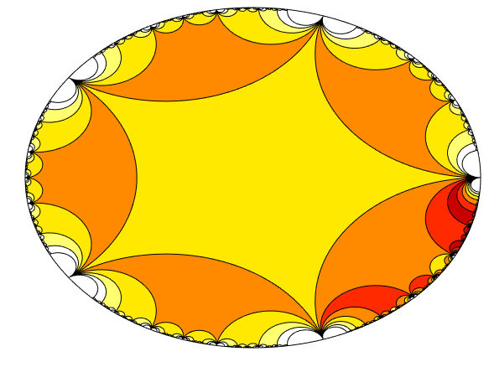
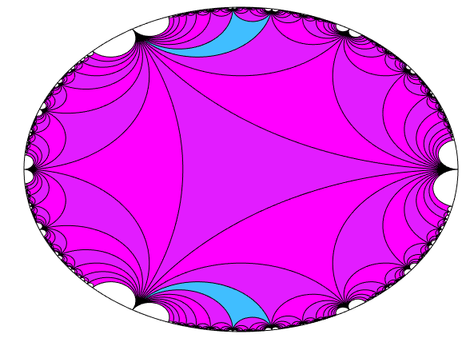
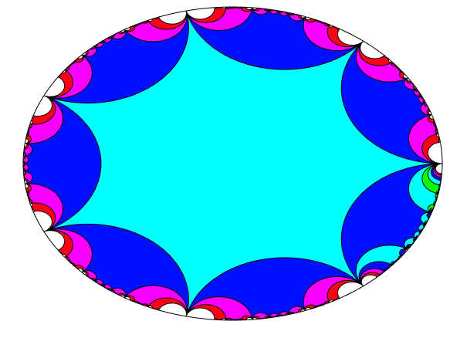
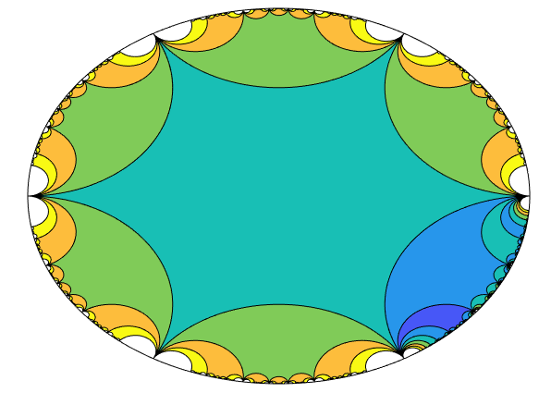

Slide 35
Before, I started with a polygon and applied certain isometries to make a tiling. If I start with a bunch of isometries, when can I find a polygon that will produce a tiling?

Slide 36
Groups of Isometries: Fuchsian Groups!
Definition: A Fuchsian Group is…
A subgroup of PSL(2,R)
Acts properly discontinuously on hyperbolic space
Each point has a neighborhood such that almost every map in our group sends that neighborhood “far away”
Within PSL(2,R), this is equivalent to being a discrete subgroup!
“Tiles nicely”

Slide 37
Groups of Isometries: Fuchsian Groups!
Possible to pick an “initial tile”, or fundamental domain, such that:
The initial tile is a (possibly non-regular) polygon
Tiles don’t overlap or get repeated
Tiles cover the entire space
Only finitely many tiles meet at any point (except maybe on the boundary)

Slide 38
Examples

Slide 39
PSL(2,Z)
Every isometry of the disk with integer coefficients
Generated by 2 elements: S: $z ↦ −1/z$ T: $z↦z + 1$
Group presentation is:
$$\left\langle ST | S^{2}=e,{\left(ST\right)}^{3}=e \right\rangle$$

Slide 40
PSL(2,Z)
The group presentation is shown in the tiling!
${\left(ST\right)}^{3}=e$, so after flipping and rotating 3 times, we come back to our original tile
This fact generalizes as Poincaré’s Theorem

Slide 41
A Punctured Torus Group
Two transformations: $z↦\frac{z+1}{z+2}$ $z↦\frac{z−1}{−z+2}$

Slide 42
Hyperbolic Surfaces
Why “Punctured Torus Group”?
Tilings can also produce quotient spaces of the hyperbolic plane
2 points are identified if an isometry in the tiling maps one to the other
Imagine gluing together the edges of our initial tile polygon

Slide 43
Image credit: http://pi.math.cornell.edu/~mec/Winter2009/Victor/part1.htm
Example: Square and hexagon tiles can make a torus*
*Actually, the quotient space omits the “corners” of the tile at infinity, so we get a torus with a hole. The normal torus does not admit a hyperbolic structure!

Slide 44
The Future: Weird Things I Don’t Know How To Code (Yet!)
Infinite-sided polygon tilings (Symbol ($∞$,p))
Semi-regular tilings
Orbifold groups
Higher Dimensions (Quasi-Fuchsian Groups)
Image credit: https://en.wikipedia.org/wiki/Uniform_tilings_in_hyperbolic_plane

Slide 45
Image Credits
Title slide: M. C. Escher, Circle Limit IV
Euclidean tilings, hyperbolic surface picture, spherical triangle, “Weird Stuff” slide: Wikipedia/Wikimedia Commons Torus Gluing:
http://pi.math.cornell.edu/~mec/Winter2009/Victor/part1.htm
Everything Else: Made in MATLAB by me
http://ibeach.github.io

Slide 46
Further Reading
Wikipedia (for more pictures) https://en.wikipedia.org/wiki/Uniform_tilings_in_hyperbolic_plane
Hyperbolic geometry notes by Caroline Series
Indra’s Pearls by Caroline Series and David Mumford
Orbifold Group (2,3,10) ?!

